Slide 1
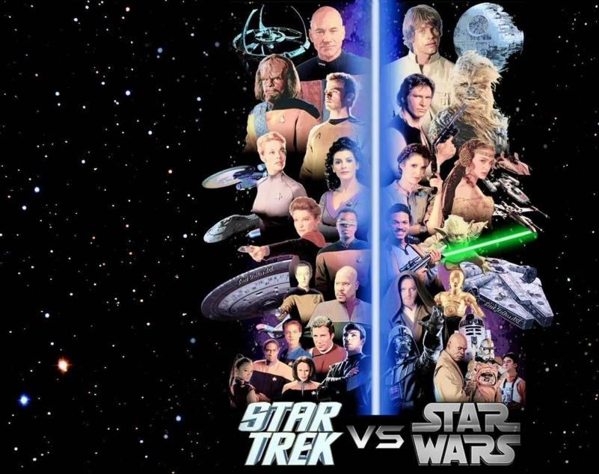
Star Trek VS Star Wars
Which Universe Has Better Data?
Wes Ward
Capstone for Nashville Software School
Data Analytics/DA8

Slide 2
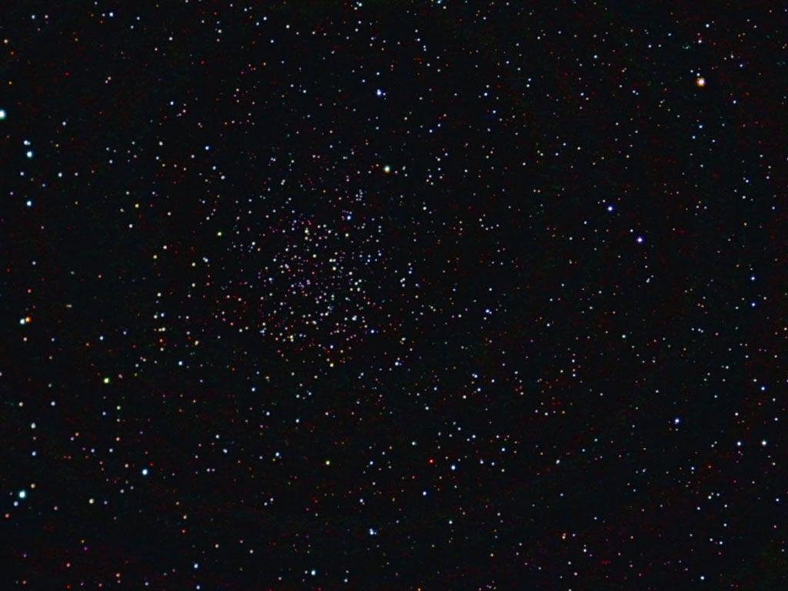
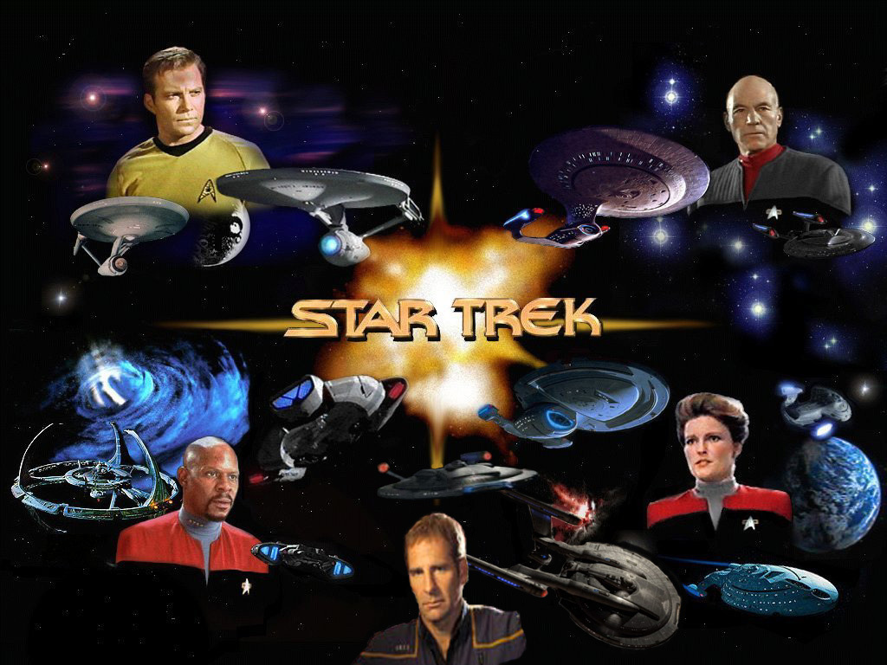
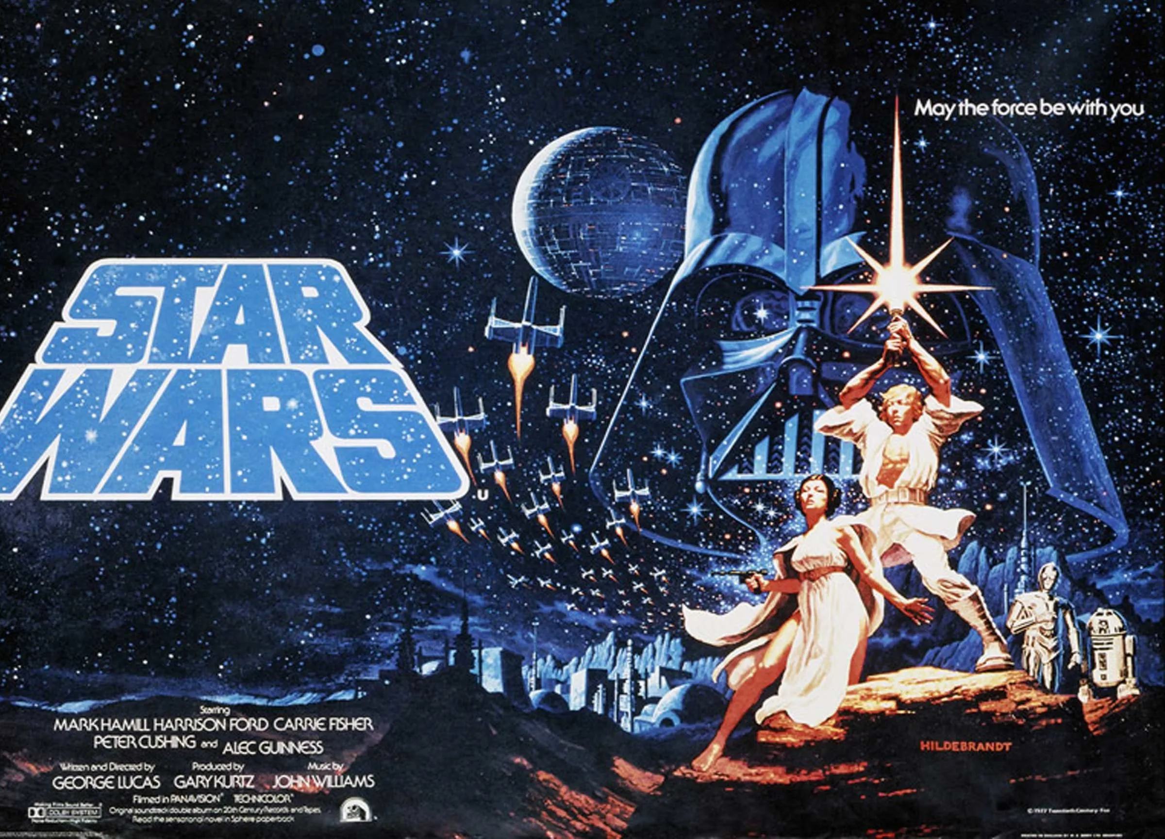
Motivation
The original goal was to compare the two biggest science fiction universes to determine which is better for the average individual living in it. After the first real comparisons, it was updated to compare the universes along with how the data is arranged, and how it correlate to the respective universe.

Slide 3
Data Sources
STAPI is a RESTful web service that provides data about the Star Trek universe, such as characters, planets, species, starships, and more. It has a simple and consistent interface that allows users to query its data easily. The URL for STAPI is http://stapi.co/.
Wookieepedia is a fan-made wiki that contains information about the Star Wars universe, such as characters, planets, species, vehicles, and more. The URL for Wookieepedia is: https://starwars.fandom.com/wiki/Main_Page.
For the Star Wars data, I used a good portion of the Wookieepedia scrape from this GitHub repository: https://github.com/dennisbakhuis/wookieepediascience. This repository contains scripts and notebooks that scrape and analyze data from Wookieepedia using Python and pandas. I modified some of the scripts to suit my needs and added some additional scraping functions. I would like to thank Dennis Bakhuis for creating and sharing this repository.

Slide 4
Challenges
Star Trek/STAPI Data
Very categorized
Often booleans only
Available for few entries
Initial STAPI Install Difficulty
Star Wars/Wookieepedia Data
Very Descriptive
Messy
Lack of Consistency
Fan Wiki
Trial and Error for Loops and Data

Slide 5
Noticeable Differences
Star Trek:
Clean
Orderly
Categorized
Scientific
Star Wars:
Messy
Diverse
Descriptive
Spiritual

Slide 6
Character Data
Star Trek/STAPI Data
Many fields to categorize Characters
Name
Gender
Height
Weight
Blood Type
Mirror/Alternate Reality/Fictional
Most of these fields are blank.
No other physical descriptions.
Star Wars/Wookieepedia Data
Many fields to describe Characters
Name
Gender
Height
Weight
Species
Homeworld
Affiliation
Most of the descriptions are difficult to group, often sub-dictionaries.

Slide 7
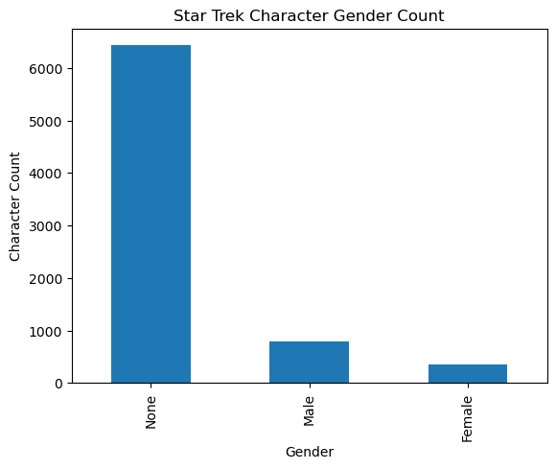
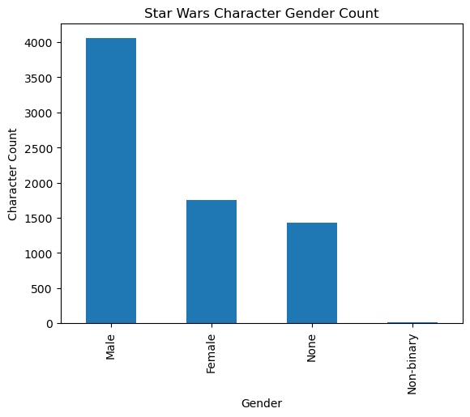
Character Genders
Both Universes had similar character counts ~ 7000+
Both universes have twice as many male as female characters.
Star Wars has Non-binary characters.
Star Trek has mostly non-described characters. We do not know if this is because it is not known or if it is because it cannot be categorized.

Slide 8
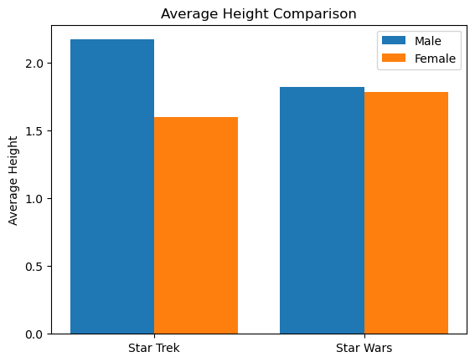
Character Height Averages
Star Trek male characters average over 2 meters tall, while female characters average just over 1.5 meters tall.
Star Wars male characters average around 1.8 meters and female characters average 1.7 meters.

Slide 9
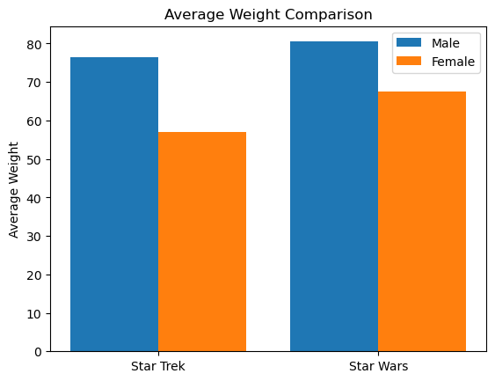
Character Weight Averages
Star Trek male characters average 77kgs, while female characters average just over 56kgs.
Star Wars male characters average 80kgs, and female characters average 69kgs.

Slide 10
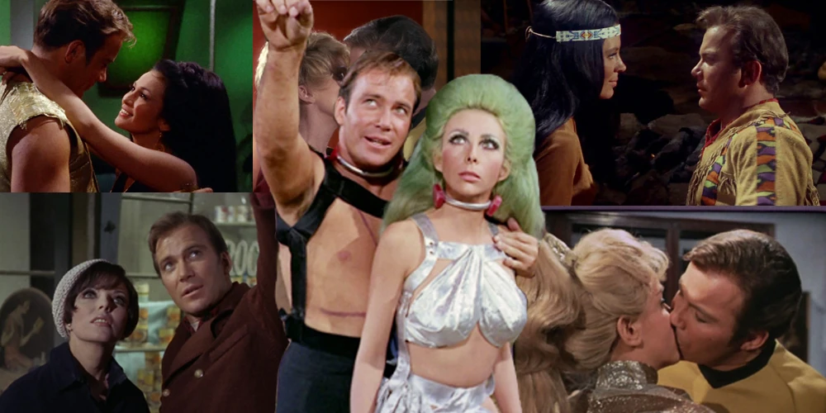
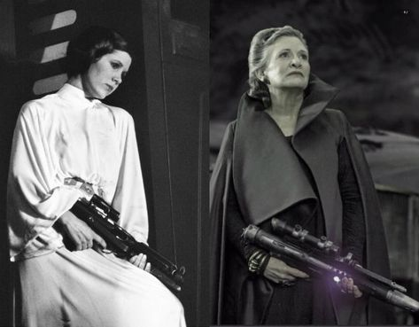


Character Observations
Star Wars is primarily male characters, but female characters are not damsels in distress. They typically have equal footing and standing as male characters.
Star Trek characters are easily categorized as manly men, diminutive women, or alien.
While there are not many, non-binary characters are also integral to the Star Wars universe.

Slide 11
Species Data
Star Trek/STAPI Data
Many fields to categorize
Name
Homeworld
Warp Capable
Extra Galactic
Spaceborne
Humanoid
Reptillian
Non-corporeal
Transdimensional
The majority of these are Booleans, and there are no other physical descriptions.
Star Wars/Wookieepedia Data
Many fields to describe Characters
Name
Average Height
Skin Colors
Hair Colors
Eye Colors
Distinctions (tendrils, face painting, horns, etc)
Social/Cultural Distinctions
Homeworld
There are lots of descriptions, and very difficult to group together.

Slide 12
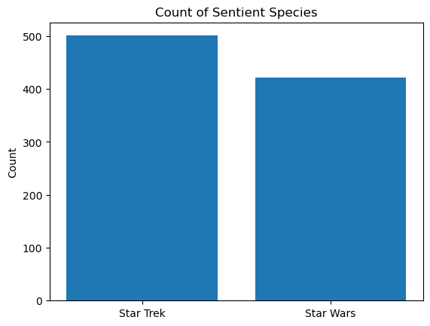
Sentient Species
Star Trek has 759 total species listed, of which, 501 were sentient.
Star Wars has 1051 total species listed, of which 422 were sentient.
Star Trek information had to compiled by determining humanoid and warp capable.
Star Wars involved cleaning data.

Slide 13
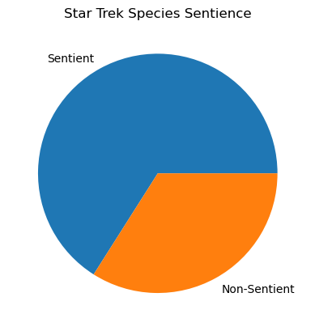
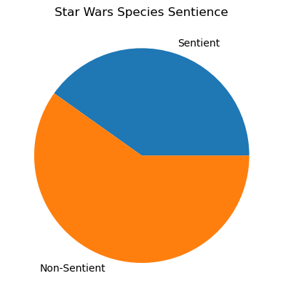
Sentient Species
Star Trek has 66% of all species as sentient, where Star Wars is less than half.
Star Trek information had to compiled by determining humanoid and warp capable.
Star Wars involved cleaning data.

Slide 14
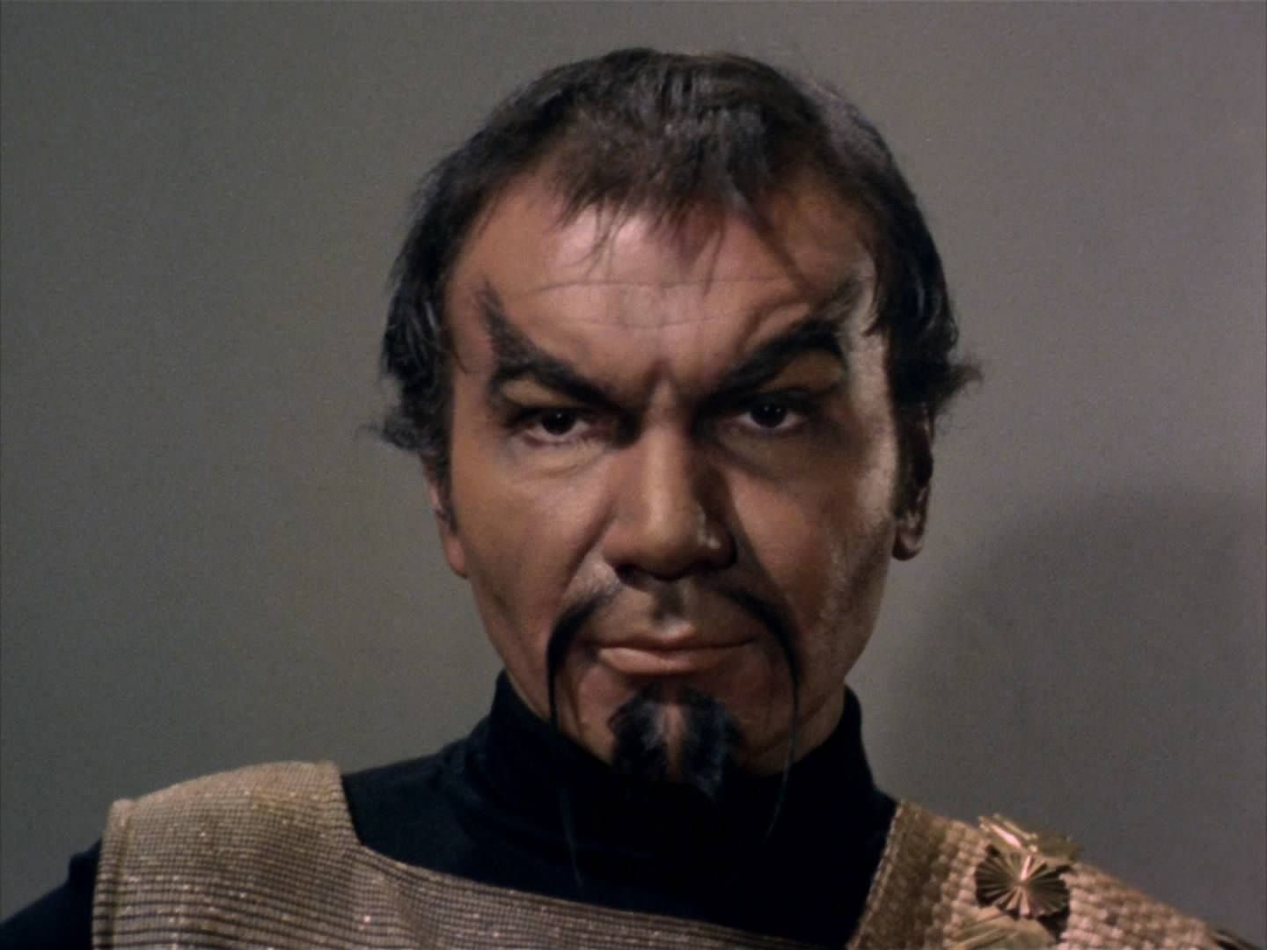
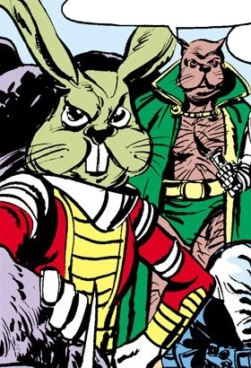

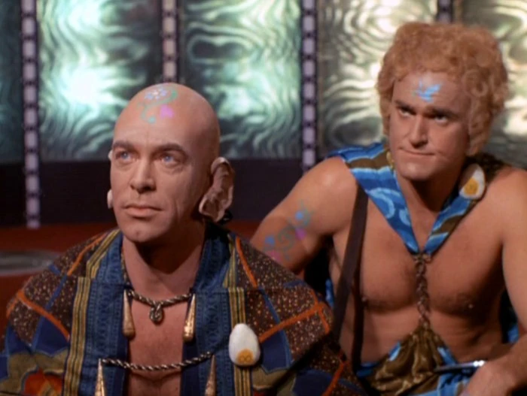
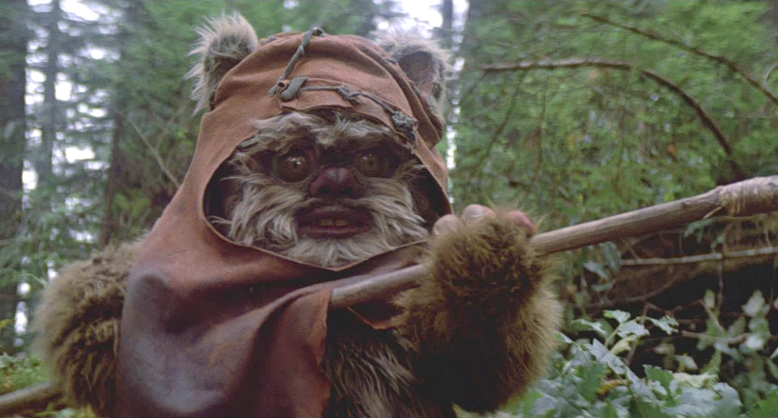
Sentient Species
Why does this matter?
Star Trek deals with species it can interact with on an intellectual level.
Star Wars is more “realistic” with farming, exploring flora and fauna of planetary bodies.
Both also have species fans would rather forget.

Slide 15
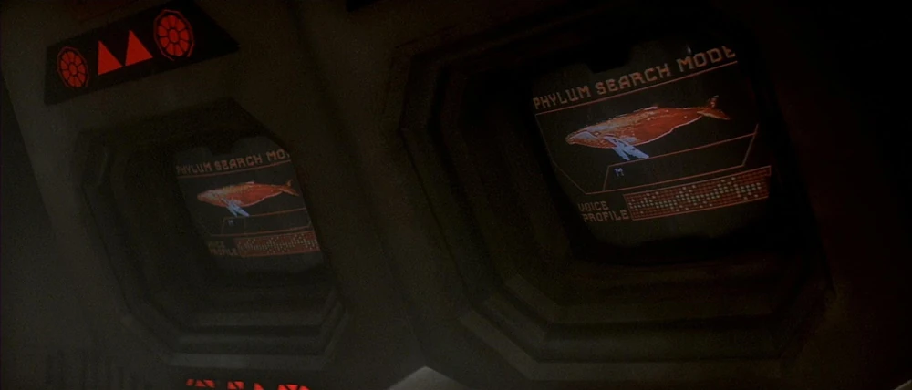
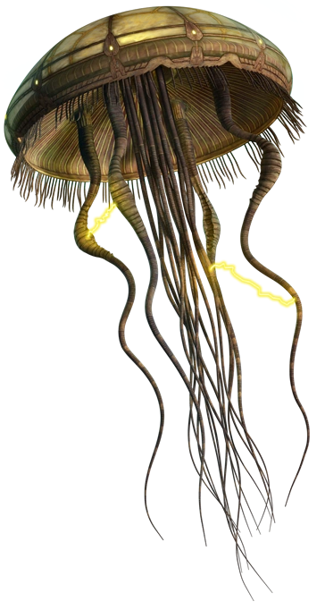
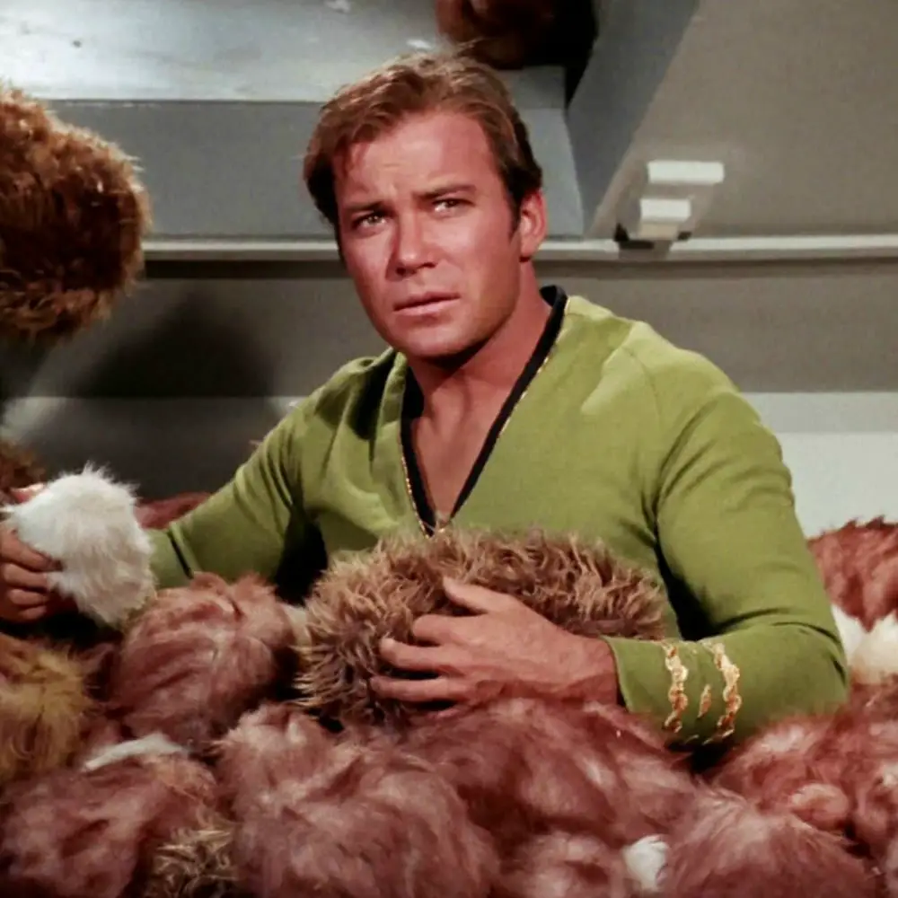
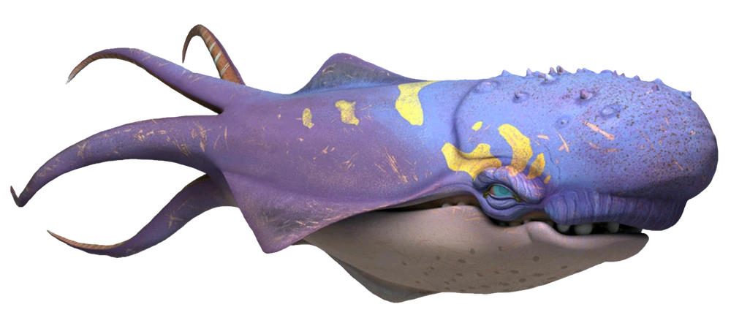
Non- Sentient Species
There are some similar species.
There are some out-there species.

Slide 16
Challenges
Star Trek/STAPI Data
Very categorized
Often booleans only
Available for few entries
Initial STAPI Install Difficulty
Star Wars/Wookieepedia Data
Very Descriptive
Messy
Lack of Consistency
Trial and Error for Loops and Data

